Slide 1

oTree workshop
Philipp Chapkovski
European University Institute
University of Hamburg
May 29-30, 2018
Day 2

Slide 2
Creating new app
open terminal
change directory to my_first_project folder
type: otree startapp pgg
Open the PyCharm
add the pgg into settings.py:
SESSION_CONFIGS = [ { 'name': 'pgg', 'display_name': "Public Good Game", 'num_demo_participants': 3, 'app_sequence': ['pgg'], }, ]

Slide 3
Which pages do we need?
Intro page: the instructions are shown. We will show it only once, at the first round
Contribution page: where they will make their decisions on contributions to the common pool
BeforeResultsWP WaitPage: where they can see the results of a round
Results page: where they can see the results of a round
FinalResults page: the overall results across all n rounds are shown. We will show it only once at the final round.

Slide 4
Which pages do we need?
class Intro(Page): pass class Contribution(Page): pass class BeforeResultsWP(WaitPage): pass class Results(Page): pass class FinalResults(Page): pass

Slide 5
page_sequence in pages.py
page_sequence = [ Intro, Contribution, BeforeResultsWP, Results, FinalResults, ]

Slide 6
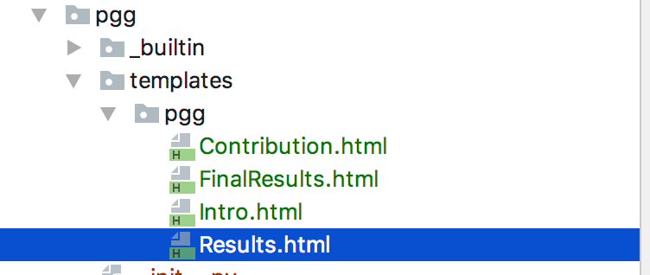
Templates
We need to create corresponding templates:

Slide 7
Conditions on showing pages
class Intro(Page): def is_displayed(self): return self.round_number == 1 ... class FinalResults(Page): def is_displayed(self): return self.round_number == Constants.num_rounds

Slide 8
Multi-round, multi-player game
class Constants(BaseConstants): name_in_url = 'pgg' players_per_group = 3 num_rounds = 2 endowment = 100 multiplier = 2

Slide 9
Fields
Each player has his/her own contribution.
The sum of contributions for the entire group
the share of total pie that will be distributed to each player in a group

Slide 10
Fields
class Group(BaseGroup): total_contribution = models.IntegerField() individual_share = models.IntegerField() class Player(BasePlayer): contribution = models.IntegerField()

Slide 11
Contribution decision
in pages.py:
class Contribution(Page): form_model = 'player' form_fields = ['contribution']
in template Contribution.html:
<h4>How much you would like to invest to a common group project:</h4> {% formfield player.contribution label='' %}

Slide 12
How do we calculate payoff?
class Group(BaseGroup): total_contribution = models.IntegerField() individual_share = models.IntegerField() def set_payoffs(self): self.total_contribution = sum([p.contribution for p in self.get_players()]) self.individual_share = self.total_contribution * Constants.multiplier / Constants.players_per_group for p in self.get_players(): p.payoff = Constants.endowment - p.contribution + self.individual_share

Slide 13
Payoff calculation line by line
self.total_contribution = sum([p.contribution for p in self.get_players()])
self.get_players() – is a method of a Group, that returns the list of all players in this group
we can loop through it obtaining or assigning values for each player in a group
so this line returns us a list of all contributions of players in a group
we assign a sum of these contributions to a group variable total_contribution

Slide 14
Payoff calculation line by line
self.individual_share = self.total_contribution * Constants.multiplier / Constants.players_per_group
we just calculated a total contribution of an entire group. Now we need to calculate how much each individual will get from the group project
this amount is the same for each player in a group. So we do it in a group level
we take a total contribution; we multiply it by multiplication factor; we divide it by total number of players in a group.

Slide 15
Payoff calculation line by line
for p in self.get_players(): p.payoff = Constants.endowment - p.contribution + self.individual_share
we loop through a list of all players in our group.
and for each player we calculate his payoff
it is:
the initial endowment
minus his/her contribution
plus the individual share from the pie

Slide 16
Calling payoff function
class BeforeResultsWP(WaitPage): def after_all_players_arrive(self): self.group.set_payoffs()
After you have create a function in a group that calculates payoffs, you need to actually call it somewhere.
It makes sense to do it when all players have made their decisions about contribution
So in after_all_players_arrive function in a Waiting Page

Slide 17
Results
<table class="table"> <tr> <td>Your initial endowment:</td> <td>{{ Constants.endowment }}</td> </tr> <tr> <td>Your contribution in this round:</td> <td>{{ group.total_contribution }}</td> </tr> <tr> <td>Your share of the group project in this round:</td> <td>{{ group.individual_share }}</td> </tr> <tr> <td>Your payoff in this round:</td> <td>{{ player.payoff }}</td> </tr> </table>

Slide 18
Results: showing previous rounds
{% if player.round_number > 1 %} <h5>In previous rounds:</h5> <table class="table"> <thead> <tr> <th>Round</th> <th>Payoff</th> </tr> </thead> {% for i in player.in_previous_rounds %} <tr> <td>{{ i.round_number }}</td> <td>{{ i.payoff }}</td> </tr> {% endfor %} </table> {% endif %}

Slide 19
Average group contributions across rounds
{% if player.round_number > 1 %} <h5>In previous rounds:</h5> <table class="table"> <thead> <tr> <th>Round</th> <th>Payoff</th> </tr> </thead> {% for i in player.in_previous_rounds %} <tr> <td>{{ i.round_number }}</td> <td>{{ i.payoff }}</td> </tr> {% endfor %} </table> {% endif %}

Slide 20
Average group contributions across rounds
class Group(BaseGroup): total_contribution = models.IntegerField() individual_share = models.IntegerField()
average_contribution = models.IntegerField() def set_payoffs(self): self.total_contribution = sum([p.contribution for p in self.get_players()])
self.average_contribution = self.total_contribution / Constants.players_per_group self.individual_share = self.average_contribution * Constants.multiplier
for p in self.get_players(): p.payoff = Constants.endowment - p.contribution + self.individual_share

Slide 21
Average group contributions across rounds
{% if player.round_number > 1 %} <h5>In previous rounds:</h5> <table class="table"> <thead> <tr> <th>Round</th> <th>Payoff</th> <th>Average group contribution</th> </tr> </thead> {% for i in player.in_previous_rounds %} <tr> <td>{{ i.round_number }}</td> <td>{{ i.payoff }}</td> <td>{{ i.group.average_contribution }}</td> </tr> {% endfor %} </table> {% endif %}

Slide 22
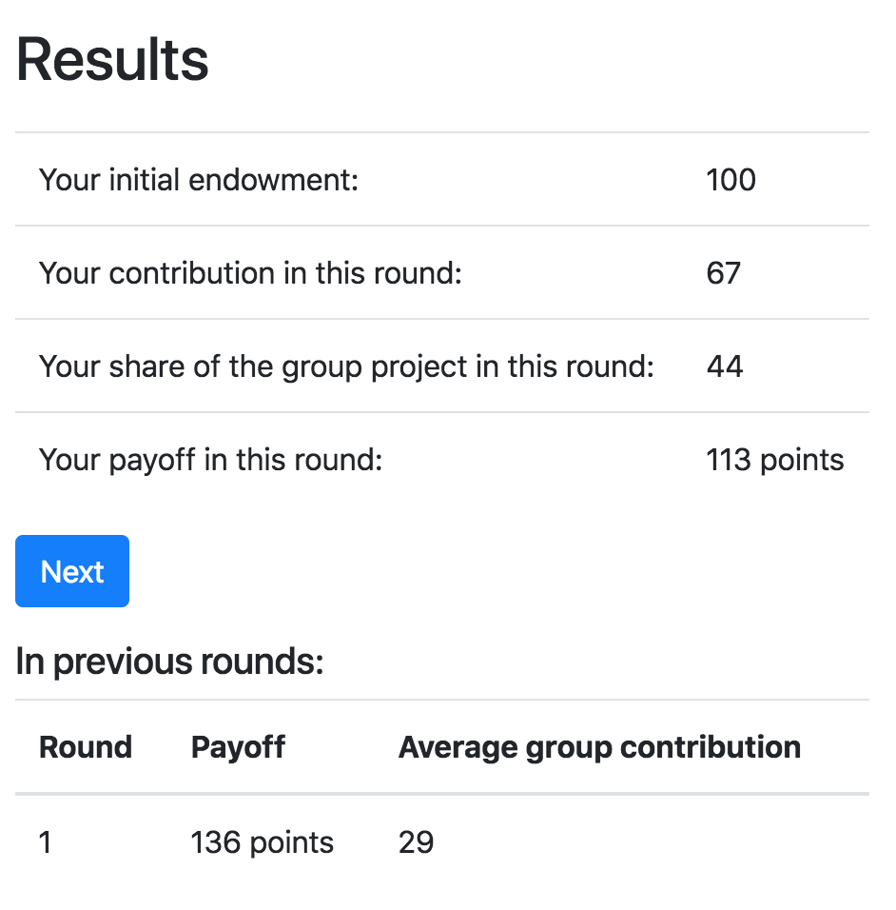
Results page:

Slide 23
Final results:
We need to show the payoffs of a particular player in each round.
And the total payoff for the entire game

Slide 24
Final results:
<h5>Your earnings:</h5> <table class="table"> <thead> <tr> <th>Round</th> <th>Average group contribution</th> <th>Payoff</th> </tr> </thead> {% for i in player.in_all_rounds %} <tr> <td>{{ i.round_number }}</td> <td>{{ i.group.average_contribution }}</td> <td>{{ i.payoff }}</td> </tr> {% endfor %} <tr class="table-success"> <td colspan="2">Your final payoff:</td> <td>{{ participant.payoff }}</td> </tr> </table>

Slide 25
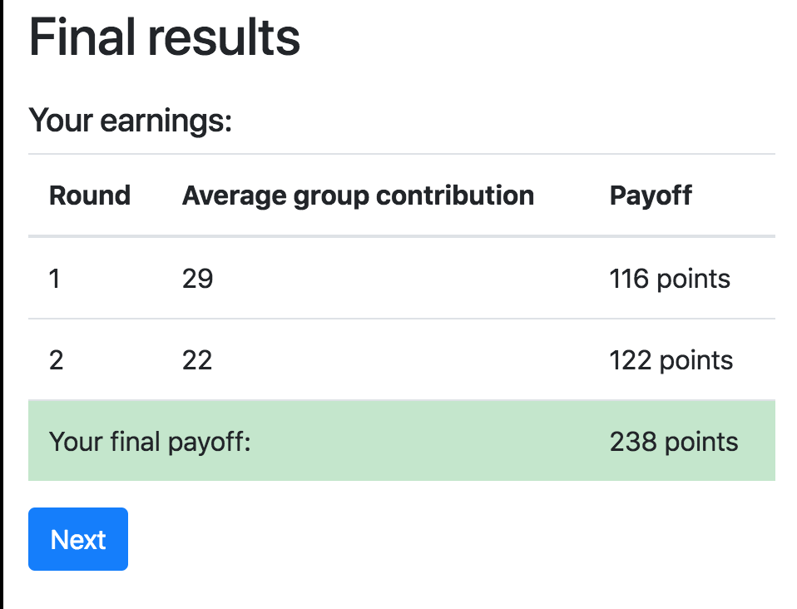
Final results:

Slide 26
Obtaining data from previous rounds
participant.get_players()
participant.payoff
player.in_all_rounds()
player.in_previous_rounds()
player.in_round(x)
player.in_rounds(x,y)
on template:
{{player.round_number}}
on page:
self.round_number

